Slide 1
Accreditation Meditation: Lessons from the Field and Tips for Success
Janice Munroe, BScPharm
Regional Pharmacy Medication Safety Coordinator, Fraser Health, BC
Julie Greenall, BScPhm, MHSc, ACPR, FISMPC
Director of Projects and Education, ISMP Canada
Canadian Society of Hospital Pharmacists
Professional Practice Conference
Sunday, January 31, 2016
Toronto ON

Slide 2
Presenter Disclosure
Presenters: Janice Munroe and Julie Greenall
ISMP Canada has received limited unrestricted honoraria from various pharmaceutical companies for educational presentations
Janice receives an honourarium from Accreditation Canada for surveys conducted
We have received no speaker fees for this learning activity

Slide 3
Commercial Support Disclosure
Janice has received support from CSHP to cover expenses associated with attending this conference to provide this presentation
Julie’s time to prepare and present today is supported through a grant from Health Canada through the Canadian Medication Incident Reporting and Prevention System

Slide 4
Disclosure
The opinions expressed are those of the speakers and may not reflect the views of Accreditation Canada.
Please consult Accreditation Canada directly for any questions related to their Standards and Required Organizational Practices.
This presentation references Version 10 of the Accreditation Standards, applicable to organizations surveyed in 2016.

Slide 5
Learning Objectives
At the conclusion of this presentation, participants will:
Understand key changes to the Medication Management Standards and Required Organizational Practices (ROPs) introduced in 2014;
Understand the surveyor perspective on how the standards are assessed;
Be aware of areas of ongoing challenge from a medication safety perspective; and
Be aware of tips and tools to support organizations in identifying potential areas of vulnerability and implementing improvements.

Slide 6
Self Assessment Questions
When is an “interdisciplinary committee approved exception” appropriate?
How will changes to the Medication Reconciliation ROP for the Emergency program and peri-operative environment affect my practice?

Slide 7
Presentation Outline
Background
Management of exceptions
New expectations for medication reconciliation
Case studies and discussion
Tools and resources

Slide 8
Background
Accreditation Canada
Qmentum
Managing Medications Standards
Revised for surveys in January 2014
Medication Management Standards
New format and flow
Focus on responsibility of the organization for medication management (not just pharmacy)
New, clearer ROPs
Exceptions introduced

Slide 9
Surveyor Selection and Training
Surveyors undergo an evaluation/screening before acceptance
Qualifications
Experience
Real-time interview
Accepted surveyors receive detailed training
Introduction to the accreditation process
Different standards
Ratings
Software

Slide 10
Surveyor Training and Commitment
On site tracer
Local hospital
Hands on experience
Receive feedback
Future surveys
Minimum of 2 per year
Maintain experience
Change in frequency of organization surveys has made this challenging

Slide 11
Competency
All surveyors are required to successfully complete annual online education modules
Varied topics
Governance
Report writing
Rating
Select Standards
Accreditation Canada coordinates a surveyor education conference every 3 years

Slide 12
Survey Planning
Developed collaboratively
Organizational quality leads
Assigned Accreditation Canada Specialist
Identify standards to be addressed
Identify sites to be evaluated
Balance assignments across surveyors
5 day survey period

Slide 13
Surveyor Challenges
Surveyors come from different walks of life
CEO
Physician
Nurse
Pharmacist
Lab Technician
Organizations are challenged to correctly interpret standards
Standards apply across different settings (community/tertiary) and jurisdictions (provincial/territorial), requiring broad language
Overlap of content between sets of standards; content is sometimes inconsistent

Slide 14
Impact of Change in Accreditation Approach
Previous survey results “met” ROPs
January 2014 - may be “unmet” AND expanded scope
Organizations need to rethink their strategies
Shifted organization’s goal from:
successful survey rating → safest system for patients
New High Alert ROP - ensures a targeted group of medications are safely handled from the time they enter the organization until they are administered to the patient.

Slide 15
High-Alert Medications
Medications with an increased risk of causing harm to a client if used incorrectly
Examples:
Opioids
Anticoagulants
Insulin
Chemotherapy
Concentrated electrolytes
Paralyzing agents
http://www.ismp.org/Tools/institutionalhighAlert.asp

Slide 16
Accreditation Canada ROP Handbook 2016; http://www.accreditation.ca/sites/default/files/rop-handbook-2016-en.pdf

Slide 17
Concentrated Electrolyte - ROP
Accreditation Canada ROP Handbook 2016; http://www.accreditation.ca/sites/default/files/rop-handbook-2016-en.pdf

Slide 18
Exceptions – Medication Management
New principle
Introduced to:
Address unanticipated situations
Impossible to meet/fulfill expectations in all practice situations
Communicate potential patient safety risks to the hospital and/or organization leadership
Ensure appropriate investigation and assessment
Allow opportunity to identify and implement mitigating strategies

Slide 19
Exceptions – Organization Considerations
Requires development of a formal process
Should be clear that exception is a “last resort”
Interdisciplinary Committee is responsible for confirming:
Situation
Options to resolve
Mitigating strategies
Interdisciplinary Committee needs to:
Document decisions
Monitor compliance
Adjust strategies over time

Slide 20
Exceptions – Organizational Decisions
Documentation of decisions also needs to meet the needs of:
Primary surveyor
Survey team
Surveyors need to understand the process and confirm that it is comprehensive and robust

Slide 21
Exceptions – Surveyor Considerations
Need to know:
What the exception approval process is
What the exceptions are
Where they can expect to see an exception
What the approved mitigating strategies are
Surveyor needs to confirm that the areas they have observed comply with the details of the exception

Slide 22
Accreditation Challenges
Standards drive change but organizations are challenged with compliance
Example: to remove products - need more commercially prepared products
Manufacturers are slow to support due to initial low demand
Forces “in-house” preparation
Increases likelihood that exceptions will be needed/used

Slide 23
Accreditation Ratings
All accreditation standards are broken down into:
Required Organizational Practices – Mandatory
Tests for Compliance
Criteria – Different Weight
Accreditation decisions are based on performance in 3 categories:
ROP and Tests of Compliance
Instrument Thresholds
High Priority Criteria and all others

Slide 24
Accreditation Ratings
Accredited with Exemplary Standing
Accredited with Commendation
Accredited
Key differences:
Exemplary requires success on all ROP tests of compliance
Percentage of met criteria (95% or more for exemplary)

Slide 25
Accreditation Ratings
Organizations typically focus on the ROPS
General and High Priority criteria are secondary
Connection between criteria and ROP
Multi-dose vials and LMWH
High Alert policy and secondary checks (barcoding or manual)

Slide 26
Examples of Challenges
Dialysis and Heparin
Different machines across Canada
Each requires different volume of heparin
Some require different sizes of syringes
Challenging to standardize commercial product needed
Calcium infusions
Need commercially available standard doses and infusion solutions
Would optimize Beyond Use Date
Reduces need for on unit dilution and approved exceptions

Slide 27
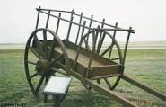
Examples of Challenges (cont’d)
Magnesium Injection
Historically, 50% most common
Early adopters shifted to 20% but numbers were small
Manufacturers see low yield if they switched from 50% to 20%
before the

Slide 28
Medication Reconciliation

Slide 29
Medication Reconciliation – ROP Changes
Embedded within practice standards
Not within Medication Management
across sites, systems, disciplines
Ongoing evolution
Increasing implementation → success!!
Modified expectations over time – reflects organizational learning

Slide 30
Accreditation Canada ROP Handbook 2016; available from: http://www.accreditation.ca/sites/default/files/rop-handbook-2016-en.pdf

Slide 31
Accreditation Canada ROP Handbook 2016; available from: http://www.accreditation.ca/sites/default/files/rop-handbook-2016-en.pdf

Slide 32
Accreditation Canada ROP Handbook 2016; available from: http://www.accreditation.ca/sites/default/files/rop-handbook-2016-en.pdf

Slide 33
Medication Reconciliation
Challenging to achieve
Improves patient safety when completed comprehensively
Potentially harmful when incomplete or rushed
Admission standards recently changed:
Emergency Department
Peri-operative

Slide 34
Former ROP: Emergency and Perioperative Services
With the involvement of the client, family, or caregiver (as appropriate), the team generates a Best Possible Medication History (BPMH) and uses it to reconcile client medications at transitions of care.

Slide 35
New ROP: Emergency Services
In partnership with clients, families, or caregivers (as appropriate), medication reconciliation is initiated for clients with a decision to admit and a target group of clients without a decision to admit who are at risk for potential adverse drug events (organizational policy specifies when medication reconciliation is initiated for clients without a decision to admit).

Slide 36
Emergency – Tests for Compliance
Medication reconciliation is initiated for all clients with a decision to admit. A Best Possible Medication History (BPMH) is generated, in partnership with clients, families, or caregivers, and documented. The medication reconciliation process may begin in the emergency department and be completed in the receiving inpatient unit.
For non-admitted clients in the target group, medication changes are communicated to the primary health care provider.

Slide 37
Changes to Emergency Standards
Need to identify “eligible” patients removed
In Emergency:
Medication history is started
Medications are not reconciled
Eligible patients are admitted
No reconciliation for those routine visits
Communication of changes occurs
Reconciliation is not performed in these environments

Slide 38
New ROP: Perioperative Services
A Best Possible Medication History (BPMH) is generated in partnership with clients, families, or caregivers (as appropriate), and used to reconcile client medications at ambulatory care visits where the client is at risk of potential adverse drug events.
Organizational policy determines which type of ambulatory care visits require medication reconciliation, and how often medication reconciliation is repeated.

Slide 39
Group Work

Slide 40
Concentrated Electrolytes ROP
Accreditation Canada Medication Management Standards, 2016

Slide 41
Concentrated Electrolytes ROP (cont’d)
Comment in Guidelines:
Accreditation Canada Medication Management Standards, 2016

Slide 42
Case Study # 1
A small hospital without overnight pharmacy services stocks sodium chloride 3% in an automated dispensing cabinet in the ICU that can only be accessed by an ICU nurse. Orders are reviewed the following morning and the medication is restocked the following day.
Does this practice meet the criteria for the ROP?
Is an exception appropriate?
Are there other strategies for safety?

Slide 43
Case Study # 2
A hospital stocks magnesium sulfate 50% in an automated dispensing cabinet on the obstetrics unit. Nurses prepare bags of 20 grams/500 mL when required, with an independent double check.
Does this practice meet the criteria for the ROP?
Is an exception appropriate?
Are there other strategies for safety?

Slide 44
Heparin ROP

Slide 45
Case Study # 3
A hospital stocks unfractionated heparin 50,000 units/5 mL in automated dispensing cabinets in ICU and hemodialysis for locking of central lines.
Does this practice meet the criteria for the ROP?
Is an exception appropriate?
Are measures in place to address other criteria (e.g., MDV)?
Are there other strategies for safety?

Slide 46
Accreditation Canada ROP Handbook 2016; available from: http://www.accreditation.ca/sites/default/files/rop-handbook-2016-en.pdf

Slide 47
Case Study # 4
Nurses are responsible for obtaining the BPMH for all patients seen in the pre-anaesthesia/pre-admission clinic. A combined BPMH/Admission order set is used. The surgeon is responsible for reviewing the BPMH and ordering medications post-operatively.
Is this considered a care transition?
Does this meet the criteria for medication reconciliation?
Does this process meet the ROP?
What are some strategies to improve the process for obtaining the BPMH?

Slide 48
Discussion
Challenges you are currently facing
Help from others

Slide 49
Tools and Resources
Accreditation Canada
Accreditation Specialists
Medication Management FAQs
Available through the portal
Accreditation Leading Practices
Peer support
CSHP Medication Safety PSN
ISMP Canada
Safety Bulletins
Medication Safety Self Assessment Programs
Medication Reconciliation Getting Started Kits and other resources

Slide 50
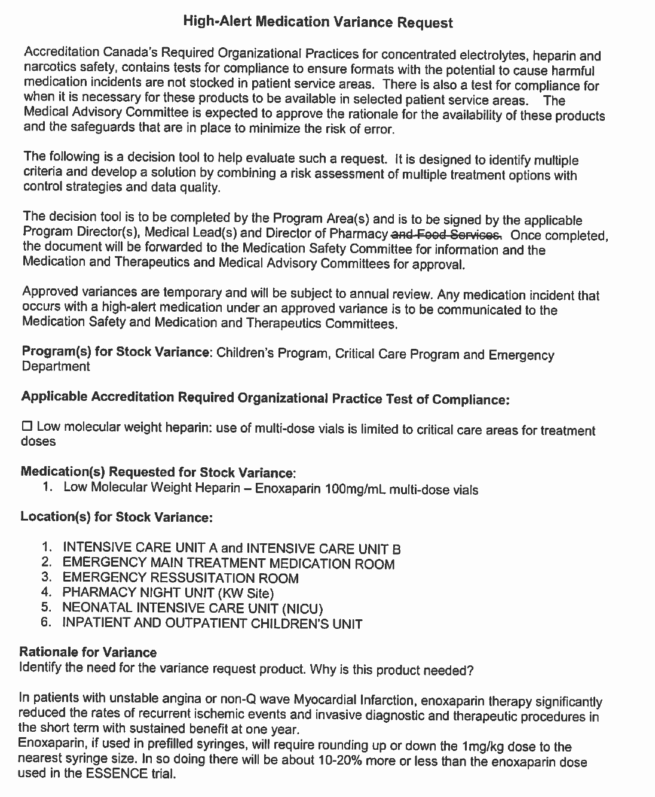
CSHP Medication Safety PSN High-Alert Medication Variance Request
Evaluation of multi-dose vials of enoxaparin
Shared with permission from Grand River Hospital and St. Mary's General Hospital
posted on the CSHP Medication Safety PSN October 2015
With acknowledgement to Vancouver Island Health Authority for their Accreditation Leading Practice

Slide 51
High-Alert Medication Variance Request (cont’d)

Slide 52
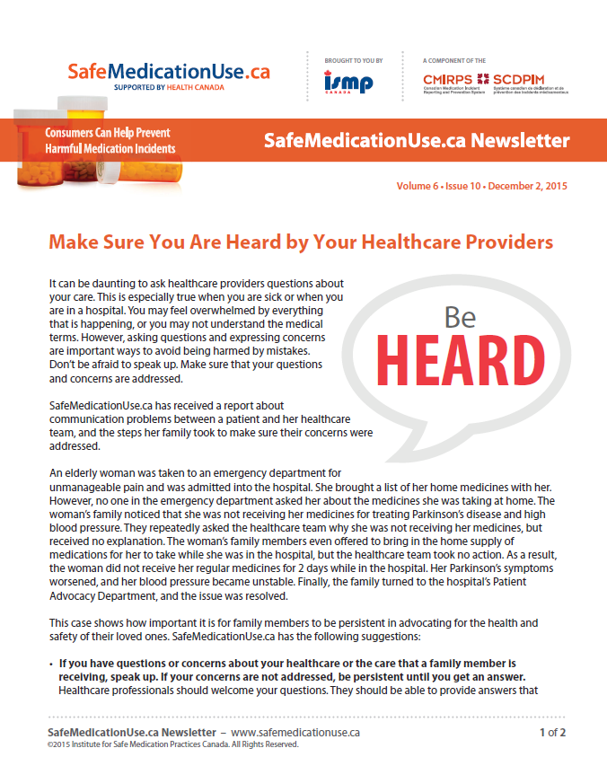
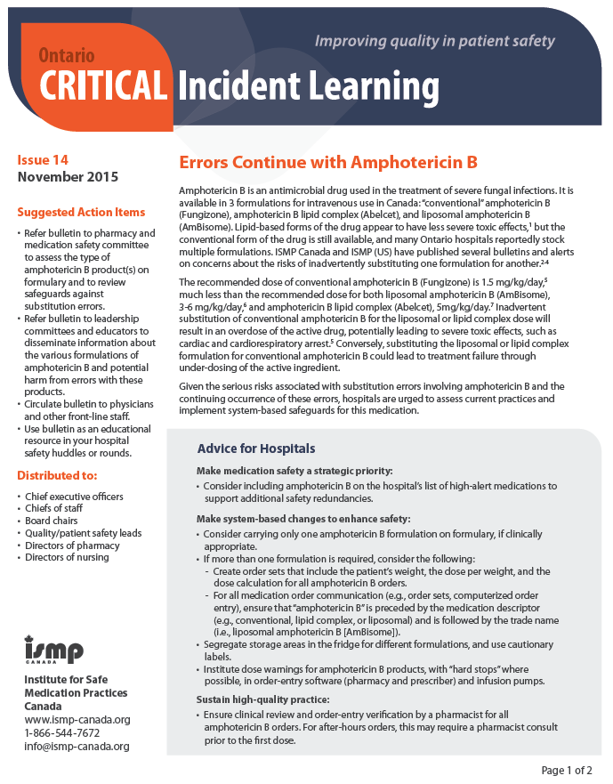
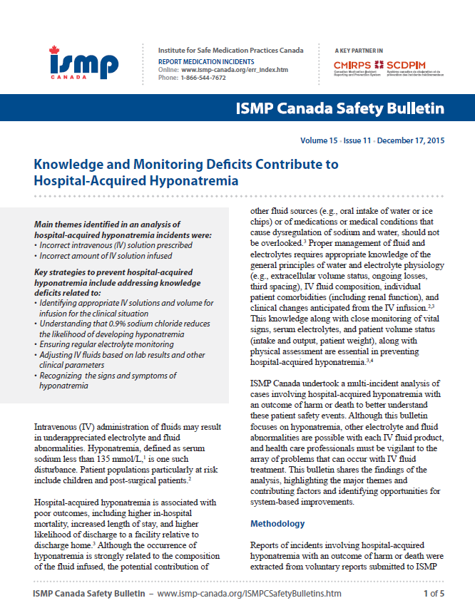
ISMP Canada Resources
ISMP Canada Safety Bulletins
Canadian Medication Incident Reporting and Prevention System (CMIRPS)
Ontario Critical Incident Learning
SafeMedicationUse.ca

Slide 53
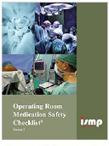
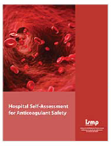
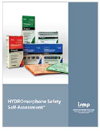
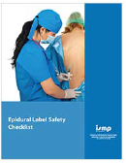
ISMP Canada Resources (cont’d)
ISMP Canada Hospital Medication Safety Self Assessments for hospitals
Canadian Version III (2016)
Specialty assessments
Oncology practice
Operating Room
Anticoagulant Safety
HYDROmorphone
Epidural Label Checklist

Slide 54
Revised Hospital MSSA – Canadian Version III (2016)
Updated from 2006 version with support from Health Canada, Ontario Ministry of Health and Long-Term Care and Health Quality Ontario
Includes new content from:
CMIRPS
Ontario Critical Incident Learning Program
ISMP (US) 2011 Hospital assessment
Accreditation Canada standards reference the MSSA as a tool for overall evaluation of the medication system
With thanks to Accreditation Canada, this version includes alignment with Medication Management Standards and ROPs

Slide 55
Medication Reconciliation Tools and Resources
Safer Healthcare Now! program funded by the Canadian Patient Safety Institute (CPSI) and led by ISMP Canada
See: http://www.ismp-canada.org/medrec/ and http://www.patientsafetyinstitute.ca/en/Topic/Pages/medication-reconciliation-(med-rec).aspx
Getting Started Kits
Acute Care and Long Term Care – revised versions available later in 2016
Home Care – revised 2015
Community of Practice
Post questions, share resources at http://tools.patientsafetyinstitute.ca/Pages/welcome.aspx

Slide 56
Conclusion
Accreditation is a strong driver of practice change and enhancements to patient safety
Difficult to make standards “perfect”; need to consider different practice environments
Rationale for exceptions
A variety of tools and resources are available to support organizations preparing for accreditation

Slide 57
Contact information
Janice Munroe
Janice.Munroe@fraserhealth.ca
Julie Greenall
jgreenall@ismp-canada.org

