Slide 1
Vanessa’s Law
Protecting Canadians from Unsafe Drugs Act
Serious Adverse Drug Reaction and Medical Device Incident Reporting

Slide 2
Outline
Protecting Canadians from Unsafe Drugs Act (also known as Vanessa’s Law)
Mandatory Reporting
Who is required to report?
What is a serious adverse drug reaction?
What is a medical device incident?
Patients as Partners in Safety
How Patients Can Submit Reports to Health Canada
How Health Canada Shares Information with the Public
Key Points to Remember

Slide 3
Protecting Canadians from Unsafe Drugs Act (Vanessa's Law)
The Protecting Canadians from Unsafe Drugs Act (Vanessa's Law) introduces the requirement for mandatory reporting of serious adverse drug reactions and medical device incidents by hospitals.
The Law improves Health Canada's ability to:
collect safety information;
take appropriate action (such as a label change or a product recall) when a serious health risk is identified; and
increase transparency (by sharing more information).
Source: https://www.canada.ca/en/health-canada/services/drugs-health-products/legislation-guidelines/protecting-canadians-unsafe-drugs-act-vanessa-law-amendments-food-drugs-act.html

Slide 4
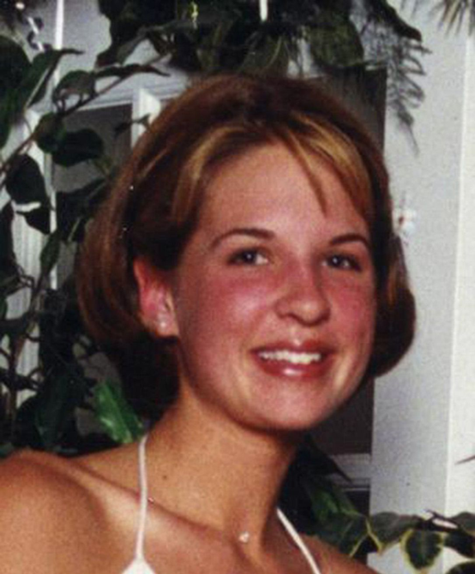
Who was Vanessa?
Vanessa Young died at the age of 15, in 2000. She experienced a cardiac problem after taking cisapride (Prepulsid®) as prescribed.
A campaign for increased regulation of drugs and devices was created.
Vanessa’s Law was enacted in 2014 and the mandatory reporting requirements come into effect December 16th, 2019.

Slide 5
Why Is Mandatory Reporting Important?
Health Canada looks at serious adverse drug reaction and medical device incident reports as an important source of information for identifying safety issues.
Under-reporting and poor quality of reports is an issue in all countries. An international review estimated that only 6% of adverse drug reactions are reported.¹
Only 6%
of adverse drug reactions are reported
¹ Hazell L, Shakir SAW. Under-reporting of adverse drug reactions: a systematic review. Drug Saf. 2006;29(5):385-396.

Slide 6
What Are the Benefits of Reporting?
Reports help to:
IDENTIFY
safety issues
ASSESS
harm versus benefit
SHARE
learning, including warnings
IMPROVE
patient and product safety

Slide 7
Who Is Required to Report?
The requirement for mandatory reporting applies to all hospitals.
The requirement applies to outpatient clinics if they are legally part of the hospital.
Health care institutions that are not defined as hospitals, such as private clinics or long-term care facilities (e.g., nursing homes), continue to be encouraged to report on a voluntary basis.
Source: https://www.canada.ca/en/health-canada/services/drugs-health-products/medeffect-canada/adverse-reaction-reporting/mandatory-hospital-reporting/drugs-devices/guidance.html

Slide 8
What is a Serious Adverse Drug Reaction?
Serious adverse drug reactions are harms from a drug that are severe enough to result in hospital admission, birth defects, long-lasting disability or incapacity, a life-threatening medical situation, or death.
Examples of Serious Adverse Drug Reactions
Kidney damage from a diuretic (water pill) that requires dialysis
Lung damage from a chemotherapy drug that requires long-term oxygen therapy
Allergic reaction to an antibiotic that is life-threatening
Adapted from: https://www.canada.ca/en/health-canada/services/drugs-health-products/medeffect-canada/adverse-reaction-reporting/mandatory-hospital-reporting/drugs-devices/guidance.html
Notes:
The legal definition:
serious adverse drug reaction is a noxious and unintended response to a drug that occurs at any dose and that:
requires in-patient hospitalization or prolongation of existing hospitalization,
causes congenital malformation,
results in persistent or significant disability or incapacity,
is life-threatening,
or results in death.

Slide 9
What is a Medical Device Incident?
Medical device incidents are problems with any type of medical product or equipment that led to or could have led to a serious health concern.
Examples of Medical Device Incidents
An infusion pump stopped working and did not give an alarm. The patient needed a longer stay in hospital.
A defibrillator used to treat a cardiac arrest did not work properly. The patient was not revived.
A prosthetic knee replacement failed due to damaged material.
A breast implant was suspected of causing a rare cancer.
Adapted from: https://www.canada.ca/en/health-canada/services/drugs-health-products/medeffect-canada/adverse-reaction-reporting/mandatory-hospital-reporting/drugs-devices/guidance.html
Notes:
The legal definition:
A medical device incident is an incident related to a failure of a medical device or a deterioration in its effectiveness, or any inadequacy in its labelling or in its directions for use that has led to the death or a serious deterioration in the state of health of a patient, user, or other person, or could do so were it to recur.

Slide 10
Tips for Recognizing Harm from a Drug or Device
Harm from a drug or from a medical device can be mistaken for a symptom of a disease.
Awareness and conversation with health care providers are key components in identifying a serious adverse drug reaction or medical device incident.
Consider a serious adverse drug reaction or medical device incident if there is:
a new health problem or unexpected change in health
a sudden need for treatments, procedures or surgeries
a sudden need for a rescue drug or antidote (e.g., naloxone, epinephrine, glucagon)
a sudden need to change treatment (e.g., stop a drug or device)
A serious adverse drug reaction or medical device incident can occur shortly after beginning treatment or much later

Slide 11
We All Have a Role in Safety
Health Care Organizations
Patients and Consumers
Health Care Product Manufacturers
Federal and Provincial Governments
Health Care Provider Educators
Health Care Providers
Media
International Monitoring Organizations

Slide 12
Patients as Partners in Safety
Patients and families ask questions and monitor their treatments.
The 5 Questions to Ask about your Medications is a helpful resource.
Patients and families can also report.
If you suspect that harm has been caused by a drug or device, you may talk to your health care provider about submitting a report.
You may also submit reports directly to Health Canada
Source: https://www.ismp-canada.org/medrec/5questions.htm

Slide 13
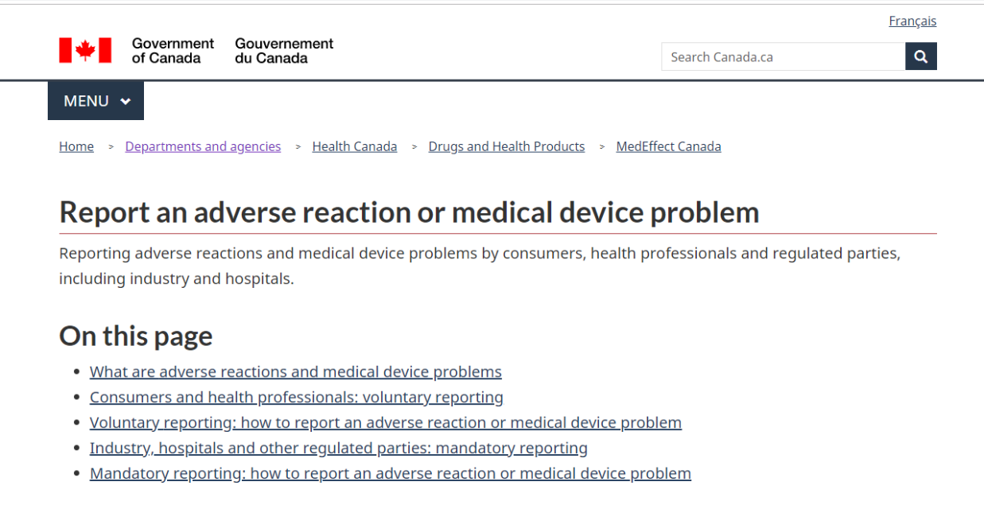
How Patients Can Submit Reports to Health Canada
The Report an Adverse Reaction or Medical Device Problem web page provides access to more information and forms.
Source: https://www.canada.ca/en/health-canada/services/drugs-health-products/medeffect-canada/adverse-reaction-reporting.html

Slide 14
Patients Can Contact Health Canada
The Canada Vigilance Program collects and assesses reports of harm involving health products marketed in Canada.
Voluntary Reporting for Health Products
Online form: https://hpr-rps.hres.ca/static/content/form-formule.php
Telephone: 1-866-234-2345 (toll-free)
Fax or Mail: Download, print and complete the Side Effect Reporting Form (please read the instructions before completing the form)
Fax: 1-866-678-6789 (toll-free)
Mail: Canada Vigilance Office (using the postage paid label)
You can report medical device incidents to Health Canada by completing a Health Product Complaint Form

Slide 15
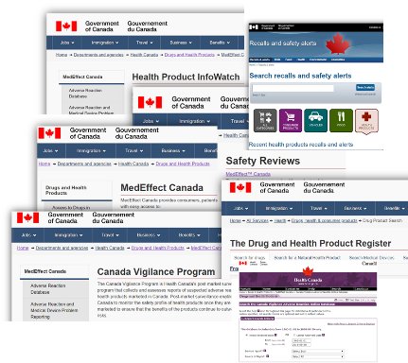
How Health Canada Shares Information with the Public
Health Canada shares findings with the public to alert and educate about risks related to health products.
Multiple sources of safety information are available:
Adverse Reaction Online Database (https://www.canada.ca/en/health-canada/services/drugs-health-products/medeffect-canada/adverse-reaction-database.html)
Medical Device Incidents Database (https://hpr-rps.hres.ca/mdi_landing.php)
Annual AR/MDP Trends Report (https://www.canada.ca/en/health-canada/services/publications/drugs-health-products/annual-trends-adverse-reaction-case-reports-health-products-medical-device-problem-incidents.html)
Health Canada Safety Reviews (https://www.canada.ca/en/health-canada/services/drugs-health-products/medeffect-canada/safety-reviews.html)
Health Canada Recalls and Safety Alerts (http://www.healthycanadians.gc.ca/recall-alert-rappel-avis/index-eng.php?cat=3)
Health Product InfoWatch (https://www.canada.ca/en/health-canada/services/drugs-health-products/medeffect-canada/health-product-infowatch.html)
Drug and Health Product Register (DHPR) (https://hpr-rps.hres.ca/)

Slide 16
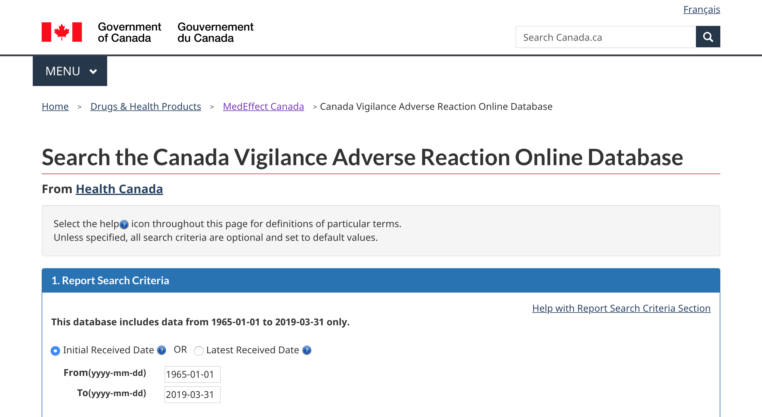
Adverse Reaction Online Database
Canada Vigilance Adverse Reaction Online Database
Searchable database with information from reports since 1965
Reports can be searched by:
report date, seriousness and source
patient information (gender, age and outcomes)
suspect health product by brand name and active ingredient
adverse reaction term or by system organ class
Source: https://www.canada.ca/en/health-canada/services/drugs-health-products/medeffect-canada/adverse-reaction-database.html

Slide 17
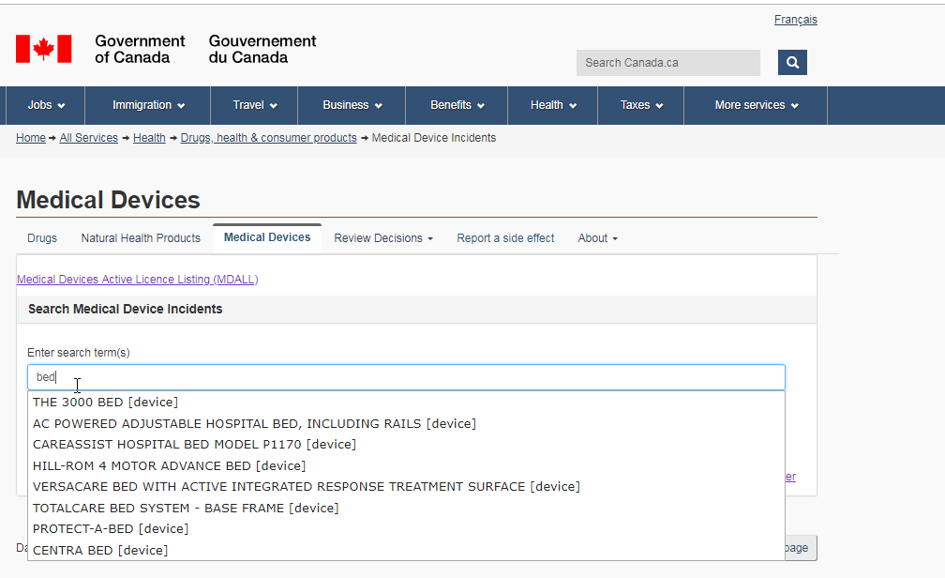
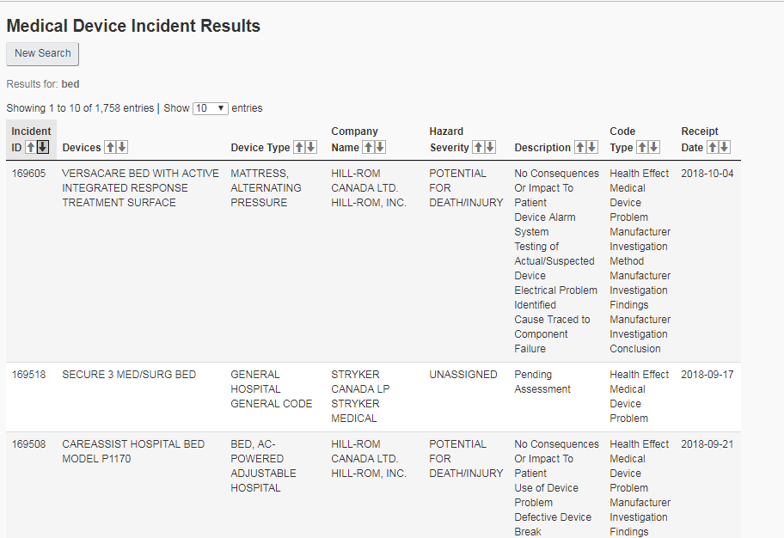
Medical Devices Online Database
Medical Device Incident Database
Searchable database with information from reports since 1980
Reports can be searched and the following data is returned:
incident ID
receipt date
device name
device type
company name
hazard severity
description
code types assigned
Source: https://hpr-rps.hres.ca/mdi_landing.php

Slide 18
Key Points to Remember
The Protecting Canadians from Unsafe Drugs Act (Vanessa's Law) introduces mandatory reporting of serious adverse drug reactions and medical device incidents by hospitals.
Reporting helps to identify safety issues, assess harm versus benefit, share learning, and improve patient and product safety.
A shared commitment to safety includes patients and families as key partners.
Patients and families ask questions and monitor their treatments, and may also submit reports.
Patients can submit reports directly to Health Canada.
Health Canada shares findings with the public to alert and educate about risks related to health products.

Slide 19
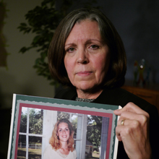
Reporting Helps Prevent Harm from Happening Again
Maryann Murray's daughter Martha died of an adverse drug reaction at age 22.
Source: https://www.patientsafetyinstitute.ca/en/toolsResources/Member-Videos-and-Stories/Pages/Patient-Safety-Stories---Martha%27s-Story.aspx

Slide 20
Acknowledgments
Adapted from: Educational Support for Mandatory Reporting. Health Canada; 2019.
Prepared by: Patients for Patient Safety Canada, in collaboration with the Institute for Safe Medication Practices Canada (ISMP Canada) and the Canadian Patient Safety Institute (CPSI)
More information is available from: https://www.patientsafetyinstitute.ca/en/toolsResources/Vanessas-Law/Pages/default.aspx
Contact: patients@cpsi-icsp.ca

